Slide 1
CS5590 Applied Programming Series
Web/Cloud/Mobile Programming

Slide 2
Introduction to AngularJS
directives, expressions, filters, modules, and controllers

Slide 3
Overview
About Angular JS
Importance of Angular JS
Elements of Angular JS
Directives
Expressions
Filters
Modules
Controllers

Slide 4
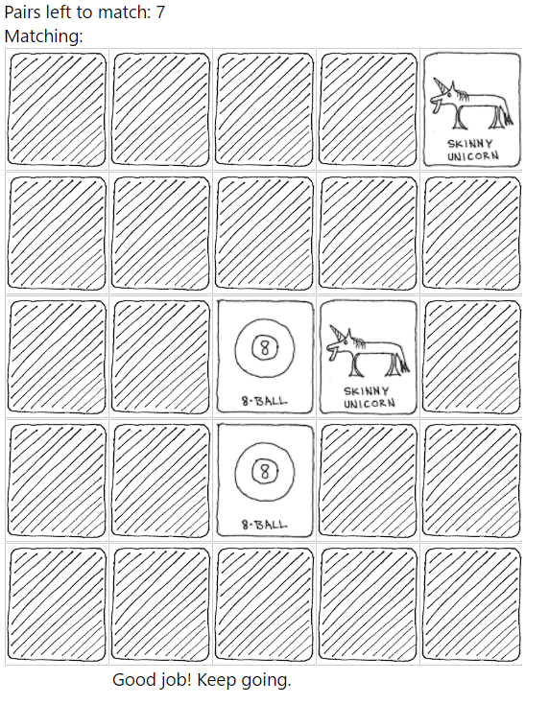
Use Case
Memory Game: Whenever matching tiles are selected user will get a congratulations message. Otherwise user will get chance to try next time.
Source: https://github.com/

Slide 5
What is AngularJS?
A client-side JavaScript Framework for adding interactivity to HTML.
AngularJS is a JavaScript-based open-source front-end web application framework
AngularJS is the frontend part of the MEAN stack, consisting of MongoDB database, Express.js web application server framework, Angular.js itself, and Node.js server runtime environment
AngularJS was originally developed in 2009 by Miško Hevery at Brat Tech LLC
Source: https://docs.angularjs.org/guide

Slide 6
Why AngularJS?
If you’re using JavaScript to create a dynamic website, Angular is a good choice.
AngularJS helps you organize your JavaScript
AngularJS helps create responsive (as in fast) websites.
AngularJS is perfect for Single Page Applications (SPAs)
AngularJS is easy to test
AngularJS is easy to learn
AngularJS extends HTML with new attributes
AngularJS Architecture
AngularJS is built around the philosophy that declarative code is better than imperative code
Source: https://docs.angularjs.org/guide

Slide 7
AngularJS Architecture
Model–View–Controller (MVC)
View :
Renders the Model data
Send User actions/events to controller
UI
View
3. Implement the Business Logic on response data and Bind it to View
1. Event or User Action or View Load
Model:
Business Logic
Notify view changes
Application Functionality
Data in general
Controller:
Define Application Behavior
Maps user actions to Model
Select view for response
Model
Controller
2. Maps to particular Model after fetching the data
Source: slideshare.com

Slide 8

AngularJS Architecture
Model–View–ViewModel (MVVM)
UI
View
User actions, commands
Data binding
Notifications
Business Logic
and Data
Presentation Logic
Model
ViewModel
Data Access
Update ViewModel about change
Source: slideshare.com

Slide 9






Web Server
How AngularJS works?
Web Browser
URL Request to server
Response with Webpage & Assets
HTML
JavaScript
Browser loads up entire webpage.
User clicks on link, new Request
Response with Webpage & Assets
HTML
JavaScript
Browser loads up entire webpage.
Source: http://campus.codeschool.com/

Slide 10



Web Server
How AngularJS works?
Web Browser
URL Request to server
Response with Webpage & Assets
HTML
JavaScript
Browser loads up entire webpage.
User clicks on link, new Request
Response with JSON Data
DATA
Data is loaded into existing page.
Source: http://campus.codeschool.com/

Slide 11
How to access AngularJS
AngularJS is a library written in JavaScript.
AngularJS is distributed as a JavaScript file, and can be added to a web page with a <script> tag:
<script src="https://ajax.googleapis.com/ajax/libs/angularjs/1.4.8/angular.min.js"></script>
Source: https://docs.angularjs.org/guide

Slide 12
How AngularJS starts?
It can be added to an HTML page with a <script> tag
The AngularJS framework works by first reading the HTML page, which has embedded into it additional custom tag attributes
Angular interprets those attributes as directives to bind input or output parts of the page to a model that is represented by standard JavaScript variables
The values of those JavaScript variables can be manually set within the code, or retrieved from static or dynamic JSON resources.
Source: https://docs.angularjs.org/guide

Slide 13
HTML Compiler
Compiler is an angular service which traverses the DOM looking for attributes. The compilation process happens in two phases.
Compile: traverse the DOM and collect all of the directives. The result is a linking function.
Link: combine the directives with a scope and produce a live view. Any changes in the scope model are reflected in the view, and any user interactions with the view are reflected in the scope model. This makes the scope model the single source of truth.
Source: http://docs.angularjs.org/guide/compiler

Slide 14
AngularJS Directives
AngularJS lets you extend HTML with new attributes called Directives.
A Directive is a marker on a HTML tag that tells Angular to run or reference some JavaScript code.
AngularJS has a set of built-in directives which offers functionality to your applications.
AngularJS also lets you define your own directives.
AngularJS directives are extended HTML attributes with the prefix ng-.
Source: https://docs.angularjs.org/guide

Slide 15
Continued…
The directives can be placed in element names, attributes, class names, as well as comments
Directives are a way to teach HTML new tricks.
A directive is just a function which executes when the compiler encounters it in the DOM.
<input ng-model='name'>
Source: https://docs.angularjs.org/guide

Slide 16
Continued…
The ng-app directive initializes an AngularJS application.
The ng-init directive initializes application data.
The ng-model directive binds the value of HTML controls (input, select, textarea) to application data.
The ng-bind directive binds application data to the HTML view.
The ng-controller directive defines the controller
Other directives - https://www.w3schools.com/angular/angular_ref_directives.asp
Source: https://docs.angularjs.org/guide

Slide 17
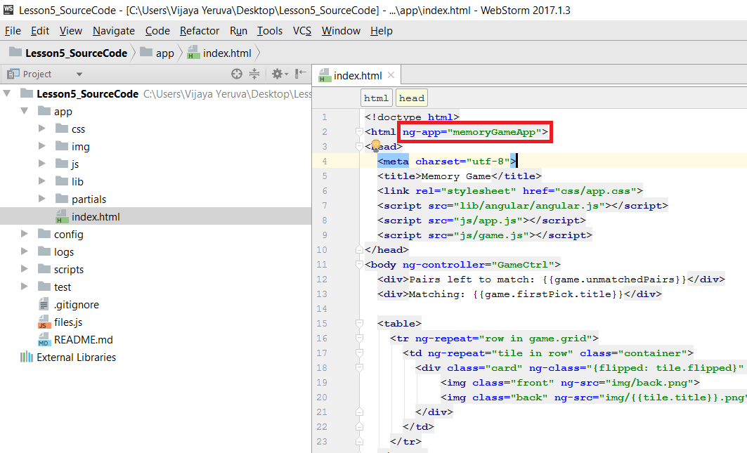
The ng-app Directive
The ng-app directive defines the root element of an AngularJS application.
The ng-app directive will auto-bootstrap (automatically initialize) the application when a web page is loaded.
Source: https://docs.angularjs.org/guide

Slide 18
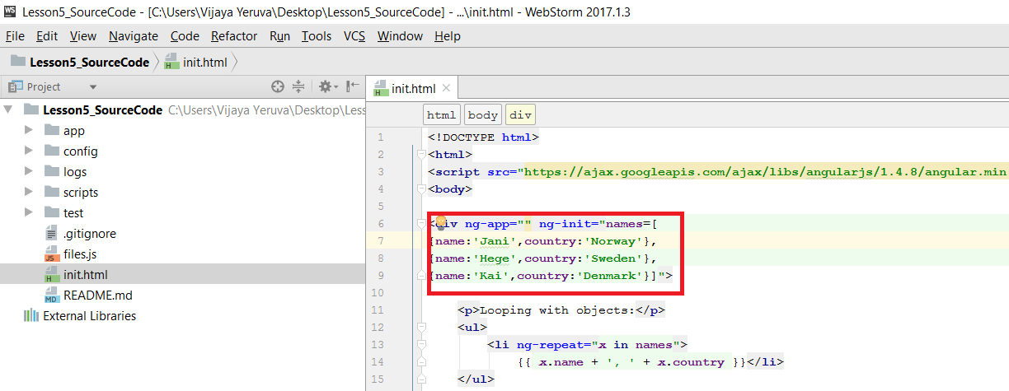
The ng-init Directive
The ng-init directive defines initial values for an AngularJS application.
Source: https://docs.angularjs.org/guide

Slide 19
The ng-model Directive
The ng-model directive binds the value of HTML controls (input, select, textarea) to application data.
The ng-model directive can also: Provide type validation for application data (number, email, required).
Provide status for application data (invalid, dirty, touched, error).
Provide CSS classes for HTML elements.
Bind HTML elements to HTML forms.
Source: https://docs.angularjs.org/guide

Slide 20
The ng-bind Directive
The ng-bind directive tells AngularJS to replace the content of an HTML element with the value of a given variable, or expression.
If the value of the given variable, or expression, changes, the content of the specified HTML element will be changed as well.
Source: https://docs.angularjs.org/guide

Slide 21
AngularJS Expressions
AngularJS binds data to HTML using Expressions
AngularJS expressions can be written inside double braces: {{ expression }}.
AngularJS expressions can also be written inside a directive: ng-bind="expression".
AngularJS will resolve the expression, and return the result exactly where the expression is written.
AngularJS expressions are much like JavaScript expressions: They can contain literals, operators, and variables.
Example {{ 5 + 5 }} or {{ firstName + " " + lastName }}
Source: https://docs.angularjs.org/guide

Slide 22
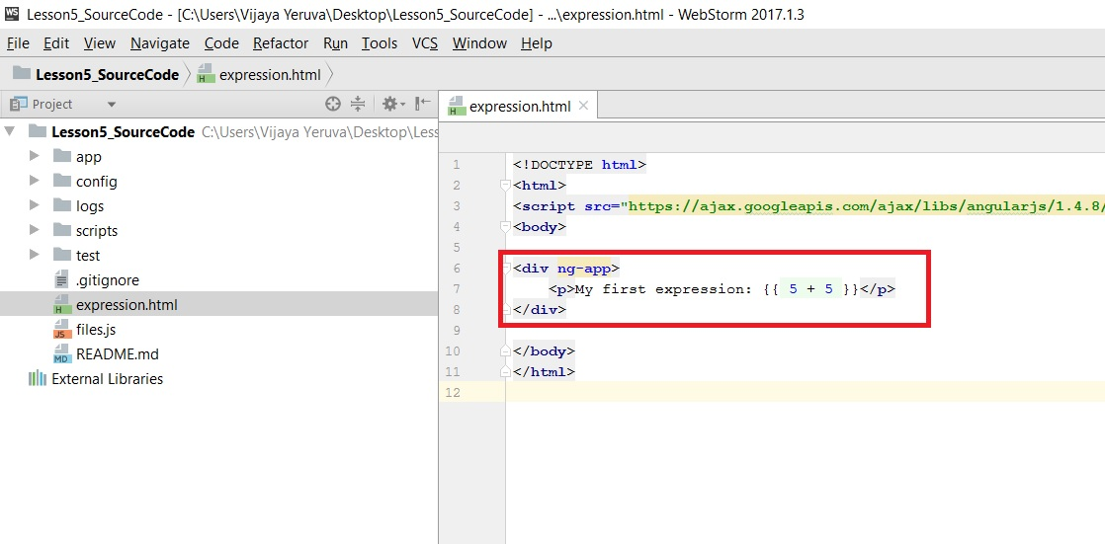
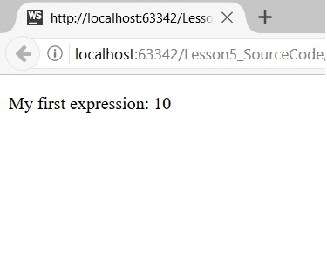
AngularJS Expressions
Source: https://docs.angularjs.org/guide

Slide 23
AngularJS Filters
AngularJS provides filters to transform data:
currency Format a number to a currency format.
date Format a date to a specified format.
filter Select a subset of items from an array.
json Format an object to a JSON string.
limitTo Limits an array/string, into a specified number of elements/characters.
lowercase Format a string to lower case.
number Format a number to a string.
orderBy Orders an array by an expression.
uppercase Format a string to upper case.
Source: https://docs.angularjs.org/guide

Slide 24
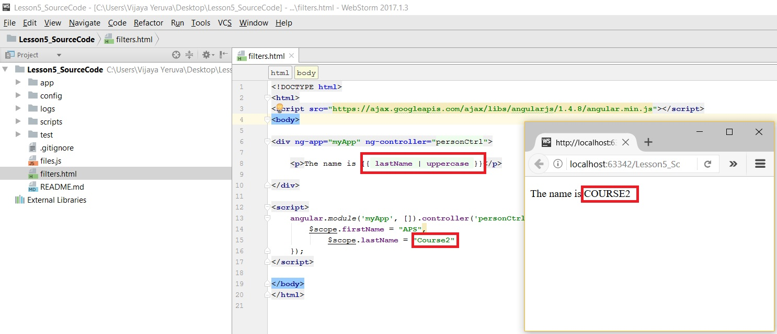
AngularJS Filters
Source: https://docs.angularjs.org/guide

Slide 25
AngularJS Modules
An AngularJS module defines an application.
To create a module we first create a variable for the app, then we will use the angular library to create a module, we give it a name and an array of dependencies, it can be an empty array if there are no dependencies.
A module is created by using the AngularJS function angular.module
var app = angular.module('store', []);
Don't forget to add the library to the html though.
Source: https://docs.angularjs.org/guide

Slide 26
Including the module
This is very simple, you just have to add it as any other script or library, add a link to the <body>
<body>
<script type="text/javascript" src="app.js"></script>
</body>
Then on the <html> tag we include np-app="store"
Source: https://docs.angularjs.org/guide

Slide 27
AngularJS Controllers
AngularJS controllers control the data of AngularJS applications.
The ng-controller directive defines the application controller.
A AngularJS controller is a JavaScript Object, created by a standard JavaScript object constructor.
Source: https://docs.angularjs.org/guide

Slide 28
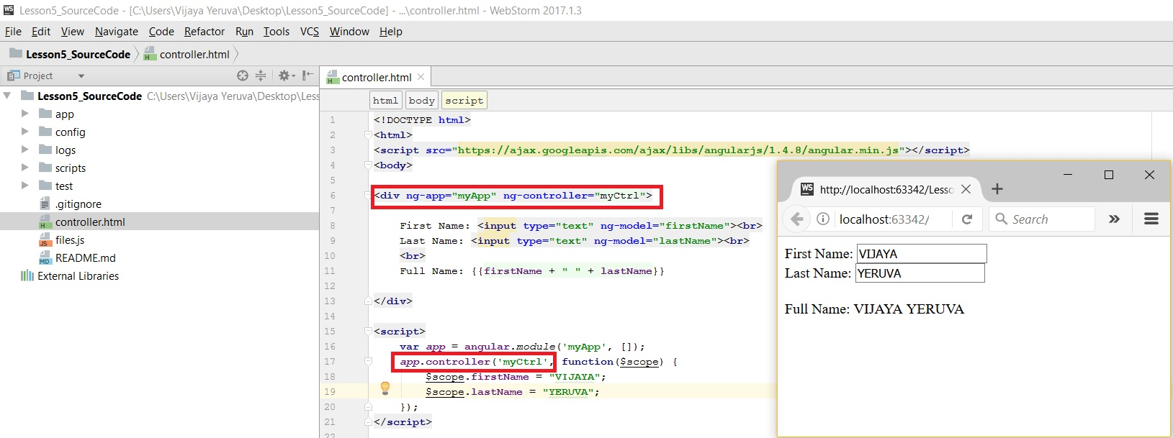
AngularJS Controllers
Source: https://docs.angularjs.org/guide

Slide 29
AngularJS Elements
The AngularJS application is defined by ng-app="myApp". The application runs inside the <div>.
The ng-controller="myCtrl" attribute is an AngularJS directive. It defines a controller.
The myCtrl function is a JavaScript function.
AngularJS will invoke the controller with a $scope object.
The ng-model directives bind the input fields to the controller properties (firstName and lastName).
Source: https://docs.angularjs.org/guide

Slide 30
Scope
If we consider an AngularJS application to consist of:
View, which is the HTML.
Model, which is the data available for the current view.
Controller, which is the JavaScript function that makes/changes/removes/controls the data.
Then the scope is the Model.
The scope is a JavaScript object with properties and methods, which are available for both the view and the controller.
Source: https://www.w3schools.com/angular/angular_scopes.asp

Slide 31
References
https://www.w3schools.com/angular/default.asp
https://en.wikipedia.org/wiki/AngularJS
AngularJS Developer Guide
AngularJS API
AngularJS Tutorial
Videos
AngularJS Fundamentals In 60-ish Minutes
Introduction to Angular JS
AngularJS end-to-end web app tutorial Part I

Slide 32
In class exercise
1. Develop a basic to-do list application using Angular JS elements which are discussed and used in Use Case
2. Develop a basic calculator application using Angular JS elements which are discussed and used in Use Case
You can use the given template for ICP or you can write code from scratch
Marks will be distributed between logic, implementation and UI

Slide 33
Feedback
Please don't forget to submit your feedback after the class. This helps a lot in increasing effectiveness of the course.
Use following link to submit your feedback: https://goo.gl/forms/YKYg28wsHo7OnOa13

